Slide 1
Digital Portfolio
STUDENT NAME: AR.VISALAKSHI
REGISTER NO AND NMID: Asunm1451222407537
DEPARTMENT: Bsc computer science
COLLEGE: COLLEGE/ UNIVERSITY Mahalakshmi women's College of arts and science/Madras University

Slide 2
PROJECT TITLE
DIGITAL PORTFOLIO

Slide 3


AGENDA
Problem Statement
Project Overview
End Users
Tools and Technologies
Portfolio design and Layout
Features and Functionality
Results and Screenshots
Conclusion
Github Link
3/21/2024 Annual Review

Slide 4

PROBLEM STATEMENT
1. Hard to show all skills in a paper resume. 2. No place to add images, videos, or project links. 3. Paper portfolios are not easy to share online. 4. Difficult to update when new work is done. 5. Need a modern way to show personal achievements.

Slide 5

PROJECT OVERVIEW
1. The project is about creating a personal digital portfolio website. 2. It will display details like name, skills, education, and achievements. 3. The portfolio will include images, videos, and project links. 4. It will be responsive and accessible on mobile, tablet, and desktop. 5. The main goal is to help showcase work and achievements in a modern, easy-to-share way.

Slide 6

WHO ARE THE END USERS?
1. Students – to showcase academic projects, skills, and achievements. 2. Job seekers – to present resumes, experiences, and portfolios to employers. 3. Freelancers – to display creative work, samples, and client projects. 4. Professionals – to highlight career achievements and expertise. 5. Institutions/Employers – to review candidate skills, projects, and suitability.

Slide 7

TOOLS AND TECHNIQUES
1. HTML, CSS, JavaScript – for creating and designing the website. 2. Frameworks (Bootstrap/React) – to make the portfolio responsive and modern. 3. Version Control (Git & GitHub) – for code management and hosting. 4. Design Tools (Canva/Figma) – to design graphics, layouts, and visuals. 5. Testing Tools (Browser DevTools) – to check responsiveness and fix errors.

Slide 8
POTFOLIO DESIGN AND LAYOUT
1. Home Page – introduction with name, tagline, and profile photo. 2. About Section – short bio, skills, and personal background. 3. Projects Section – showcase of academic/professional work with images and links. 4. Achievements/Education – details of qualifications, certifications, and milestones. 5. Contact Section – email, phone, and social media links for easy connection.
8

Slide 9
FEATURES AND FUNCTIONALITY
1. Responsive Design – works smoothly on mobile, tablet, and desktop. 2. Navigation Menu – easy access to Home, About, Projects, and Contact. 3. Project Showcase – add images, descriptions, videos, and links to work. 4. Contact Form/Links – allows visitors to connect via email or social media. 5. Customization – easy to update with new skills, achievements, or projects.

Slide 10
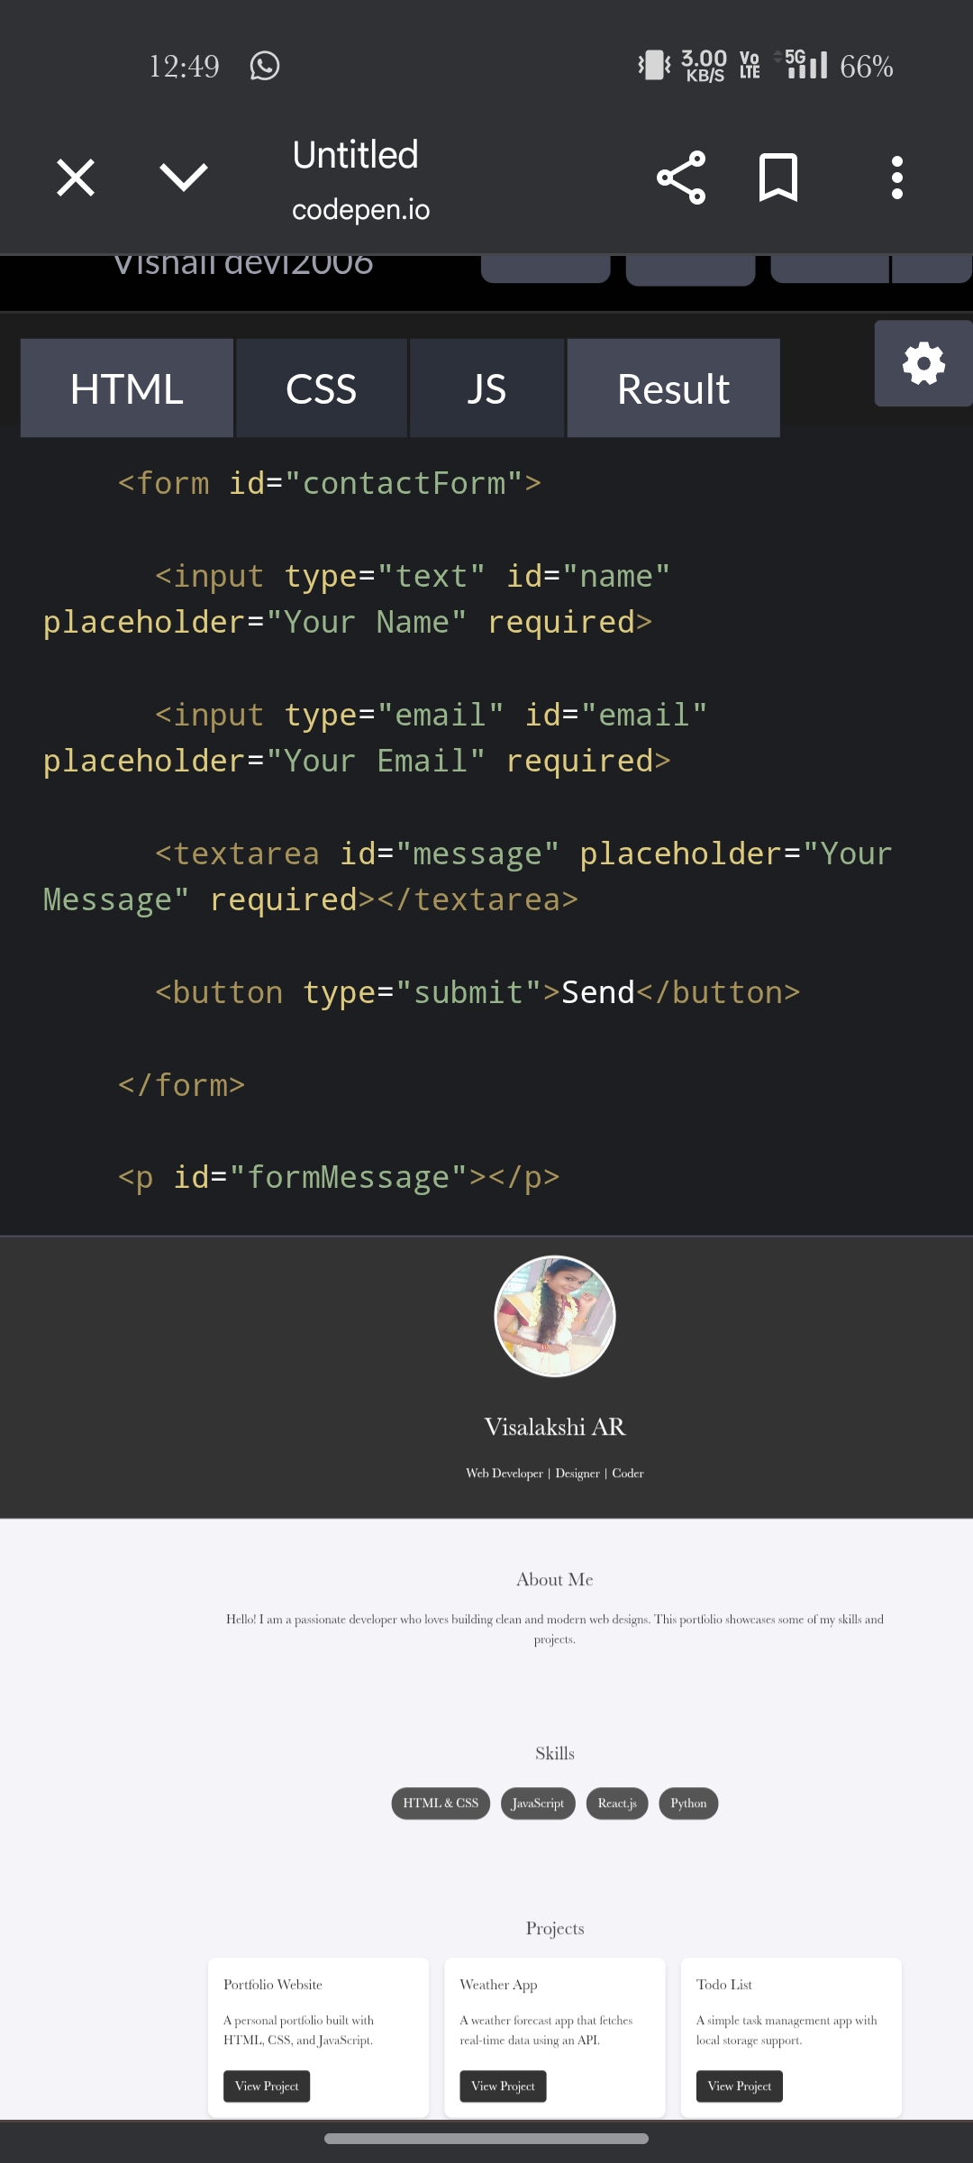

RESULTS AND SCREENSHOTS
3/21/2024 Annual Review
10

Slide 11
CONCLUSION
1. A digital portfolio provides a modern way to showcase skills and achievements. 2. It is more engaging and interactive than traditional resumes. 3. The design is user-friendly, responsive, and accessible anywhere. 4. It helps students, job seekers, and professionals present their work effectively. 5. Overall, it improves personal branding and career opportunities.
11

